Slide 1
Programming of Supercomputers
Optimization, ParallelizatioN & Tuning of GCCG solver
Team Members:
Ajay Karthik
Mahyar Valizadeh

Slide 2
Overview
First Assignment
Brief introduction on working environment
PAPI Library and usage in our implementation
Compiler optimization flags
I/O
Second Assignment (4 milestones)
Milestone #1: Data Distribution
Milestone #2: Communication Model
Milestone #3: MPI Implementation of Computation Phase and Finalization
Milestone #4: Performance Analysis and Tuning

Slide 3
First Assignment
SuperMUC infrastructure
GCCG solver and overview of the code
Low level API hardware counters
Resource usage counters used
PAPI_L2_TCA (L2 total cache accesses)
PAPI_L2_TCM (L2 total cache misses)
PAPI_L3_TCA (L3 total cache accesses )
PAPI_L3_TCM (L3 total cache misses)
PAPI FP OPS (Floating point operations)
-g, -O1, O2, -O3 & –O3 –no-opt-prefetch
Metrics (execution time, flops and cache miss rates)
Binary versus ASCII
Size
Time
Introduction
PAPI Library
Compiler Flags
I/O
Results

Slide 4
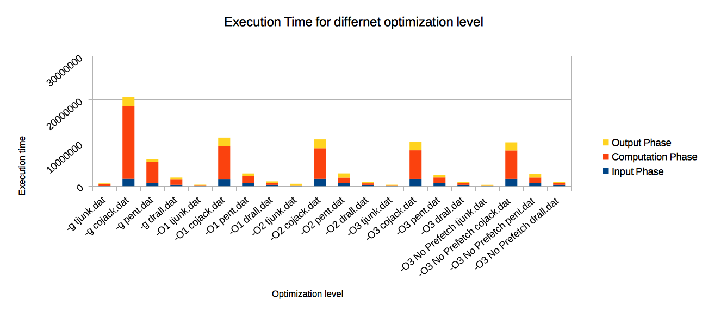
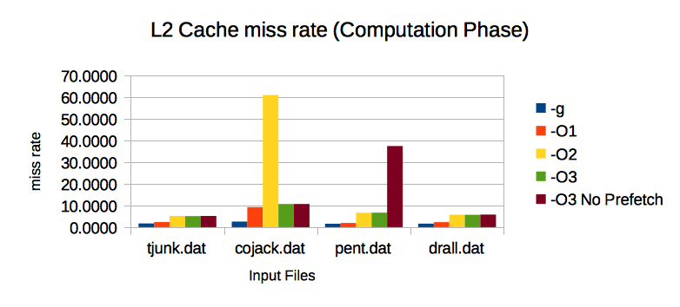
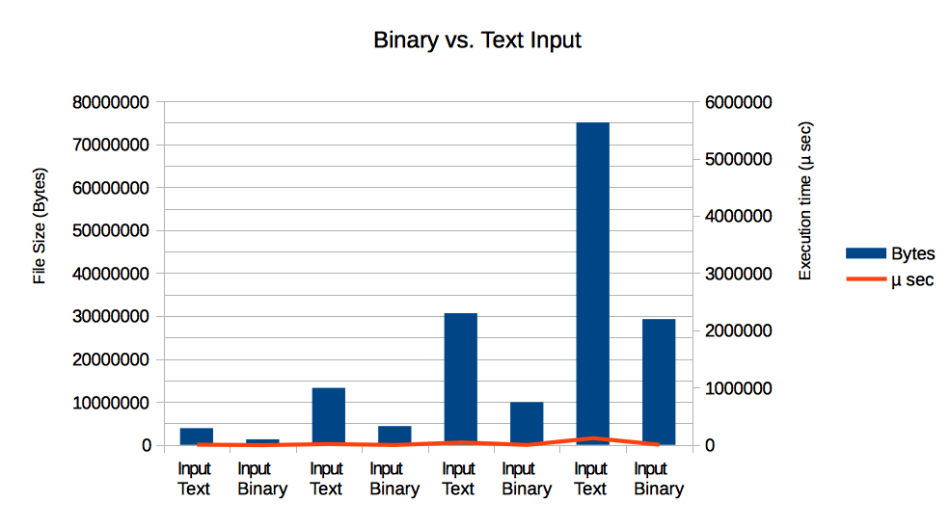
Results of First Assignment

Slide 5
Second Assignment
Local_global_index
Global_local_index – double pointer with ( rank, local index)
Local_int_cells
Distribution Approaches
Classical, METIS & our own implementation (My classical)
Formulation of send_list and recv_list with global indexes
Communicating send_list and recv_list
Send_list(left to right) = recv_list(right from left)
Examples
Data Distribution
Communication Routine
Computation in Parallel
Tuning and Performance Analysis
Results

Slide 6
Mapping Overview
Local indices:
0
1
2
3
0
1
2
3
0
1
2
3
Global indices:
0
1
2
3
4
5
6
7
8
9
10
11
My classical array distribution:
0
lcc[0][0]
lcc[0][1]
lcc[0][2]
lcc[0][3]
lcc[0][4]
lcc[0][5]
Lcc[1][0]
…
Lcc[2][0]
…
Lcc[3][1]

Slide 7
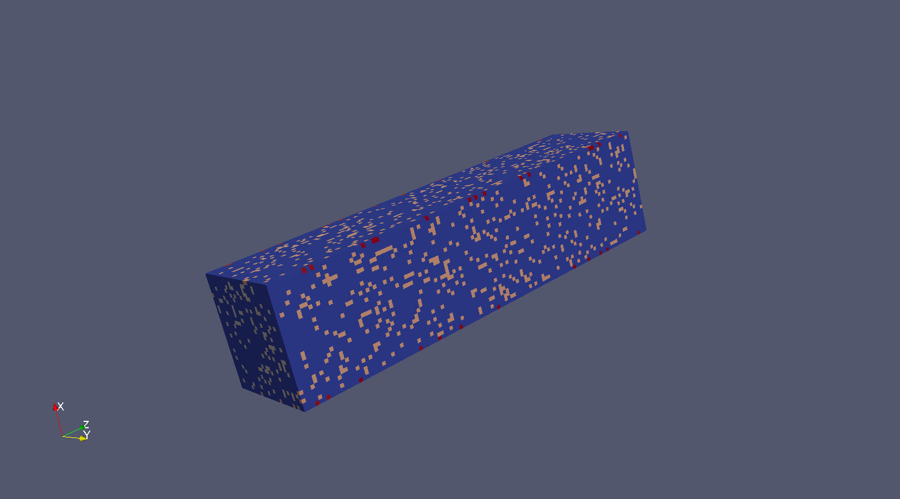
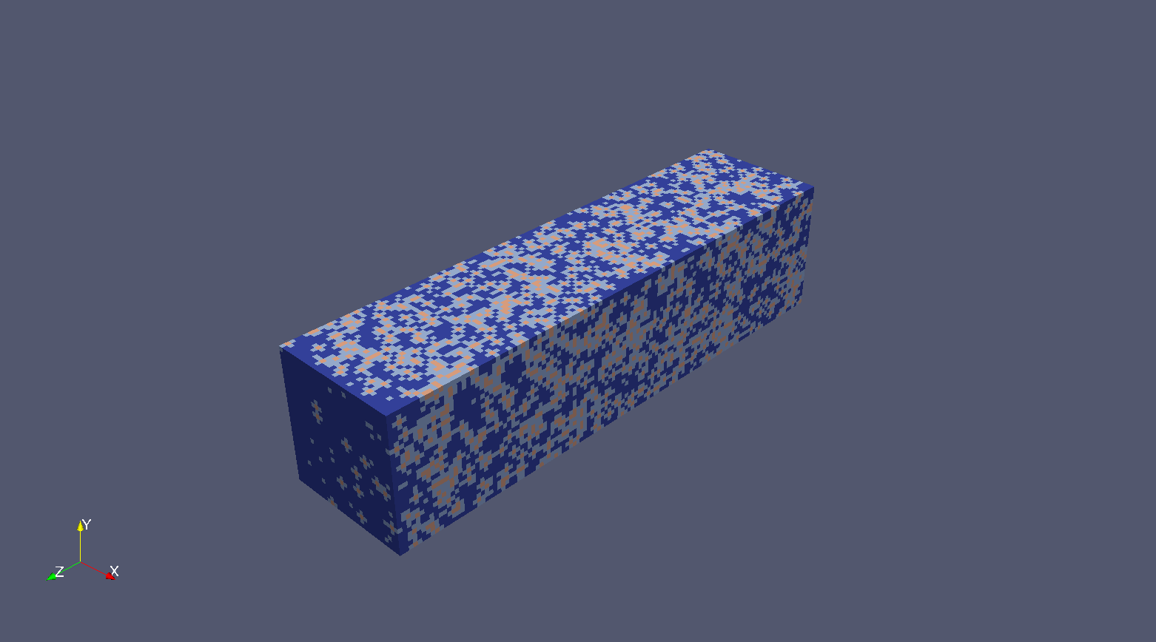
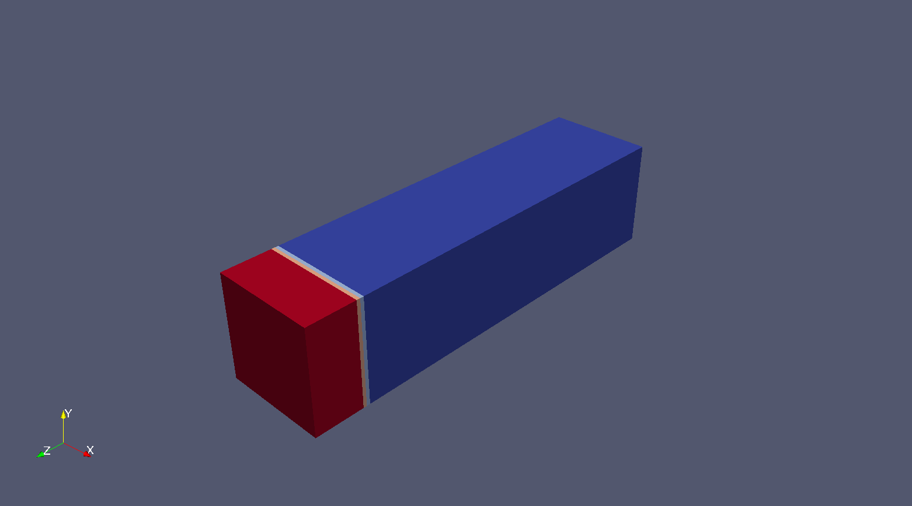
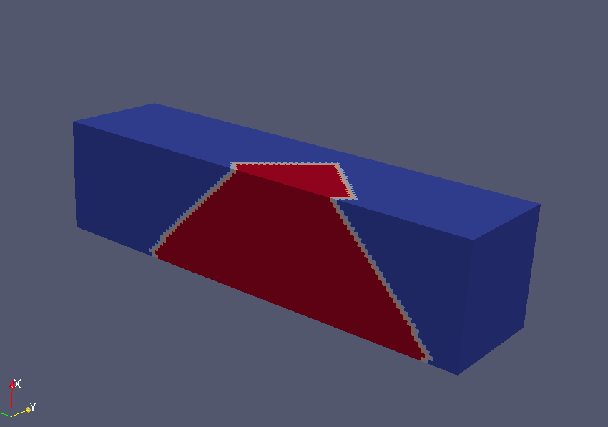
Distribution and communication examples

Slide 8
Second Assignment
MPI_type_indexed (Based on implementation for sending and receiving non-continuous data)
Collective operation (MPI_Allreduce)
Two approaches for calculation of Direc2
Binary search of recv_list
Change the size of Direc1 to keep the whole domain
Finalization
Gathering the data (cgup, var , …) needed to write the vtk files
Results
Data Distribution
Communication Routine
Computation in Parallel
Tuning and Performance Analysis
Results

Slide 9
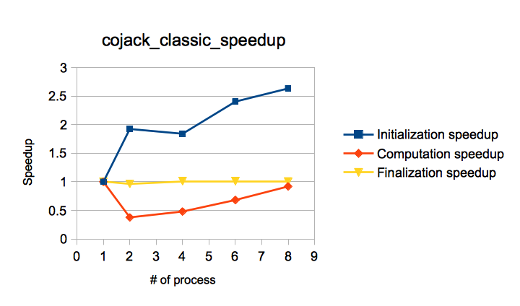
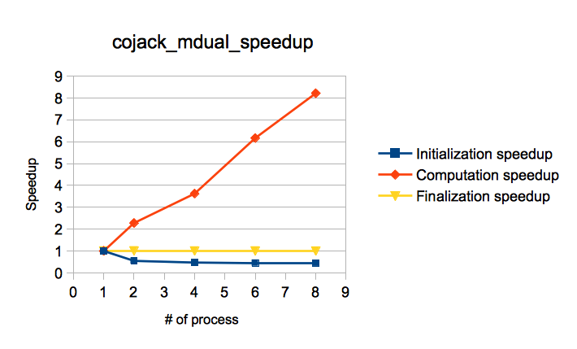
Results before tuning

Slide 10
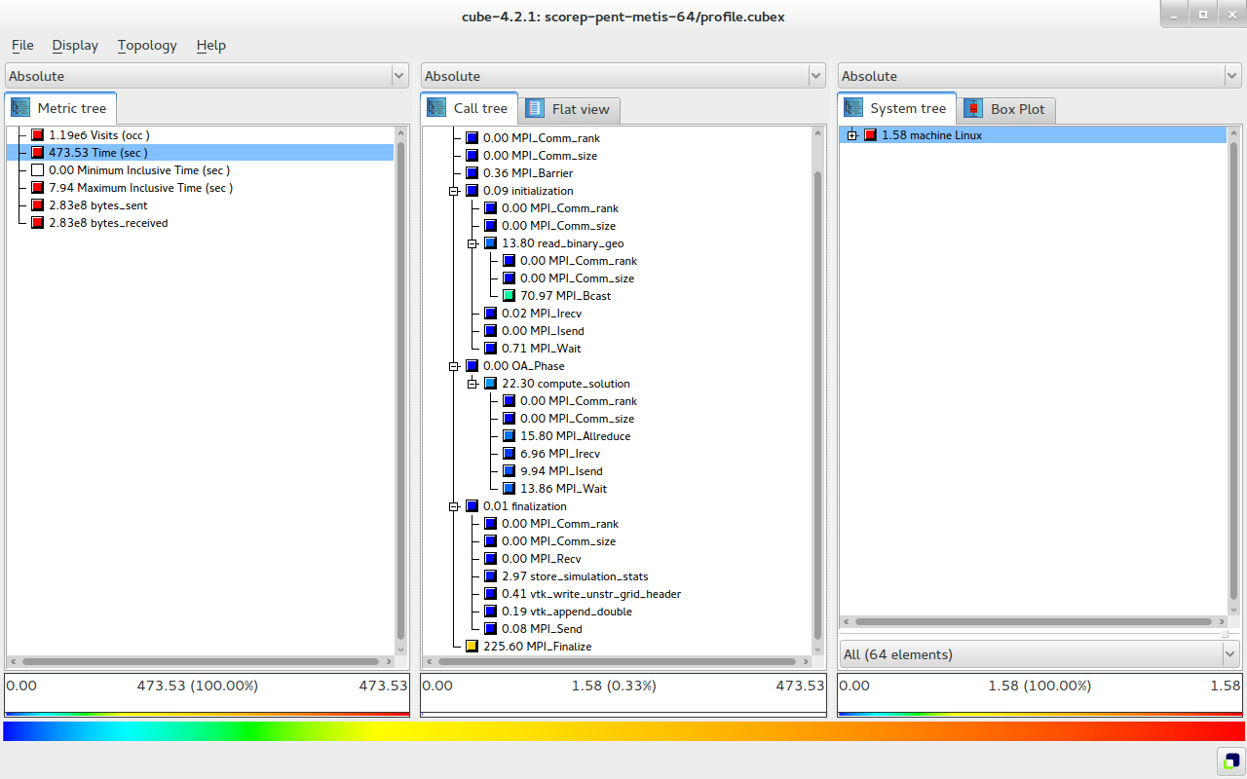
Second Assignment
Score-P instrumentation (code and makefile)
And reading produced profile with cube
Scalasca (instrumenting only the makefile)
Data Distribution
Communication Routine
Computation in Parallel
Tuning and Performance Analysis
Results

Slide 11
Finding Major drawbacks
METIS Implementation hotspots –
Communication Overhead during Broadcast of the epart array.
MPI_Allreduce
Classical Implementation hotspots –
Fast during the initialization phase → very simple logic.
In computation phase a large overhead
In direc1 communication during MPI_Isend and MPI_Wait.

Slide 12
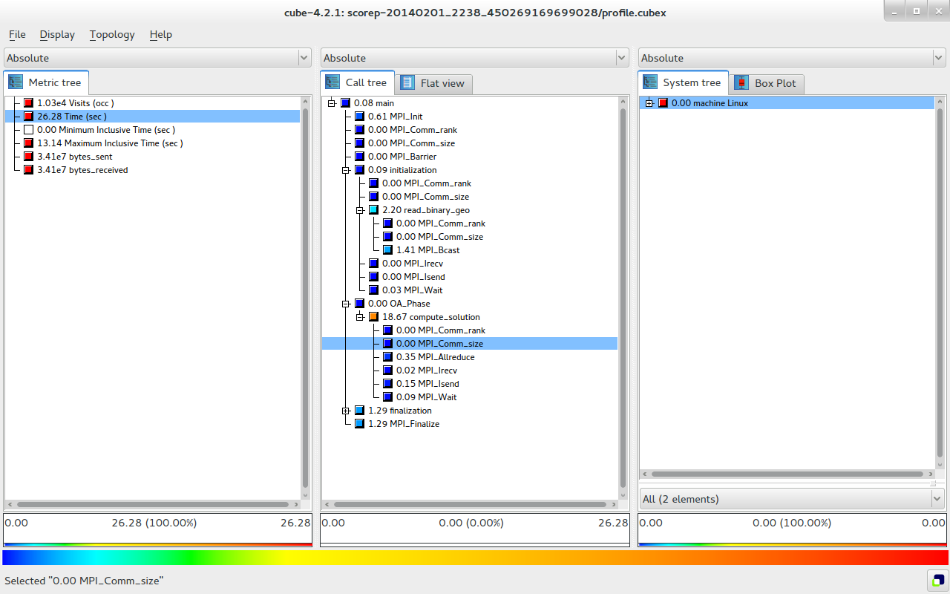
Major drawbacks (METIS)

Slide 13

Major drawbacks (Classical)

Slide 14
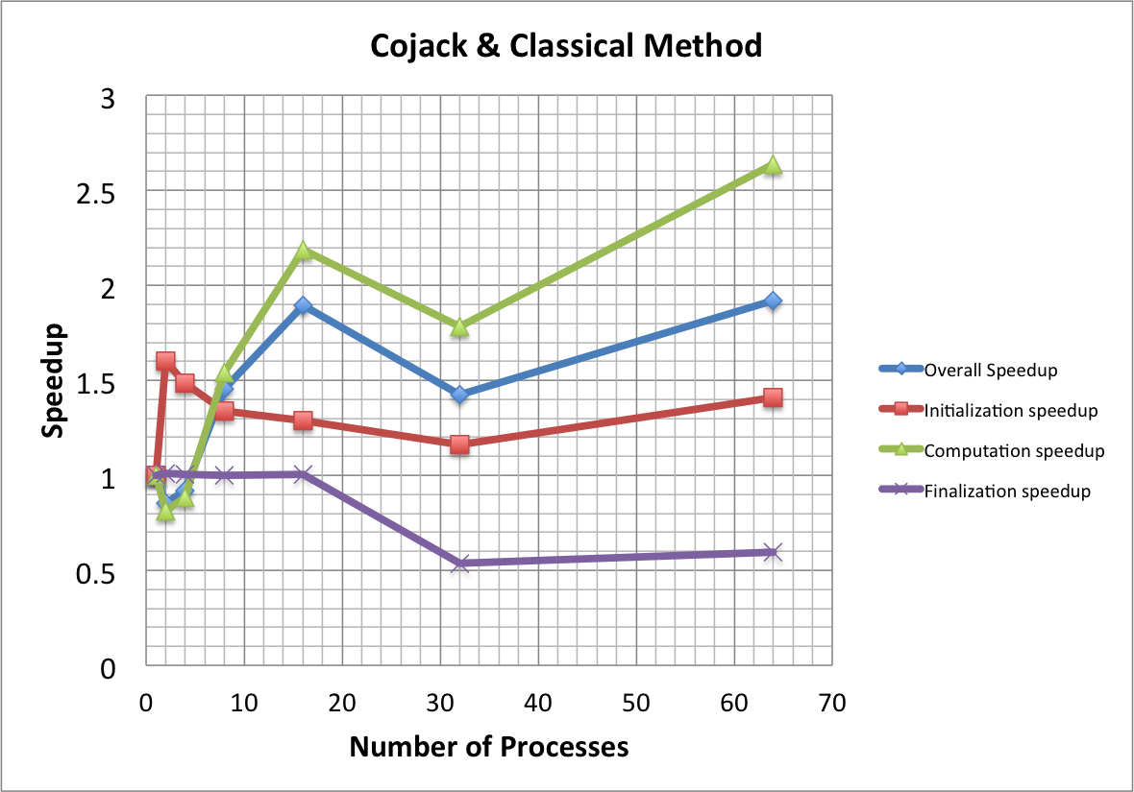
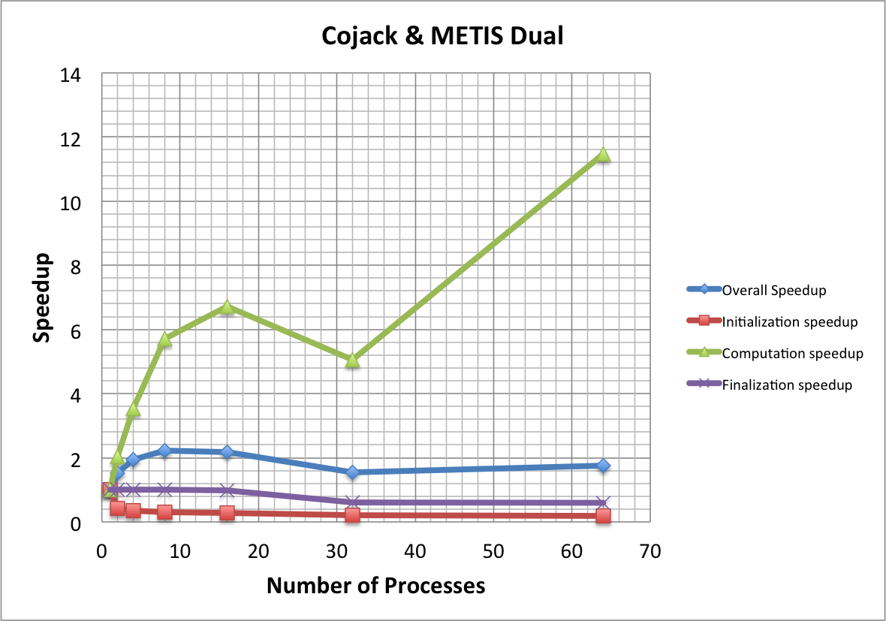
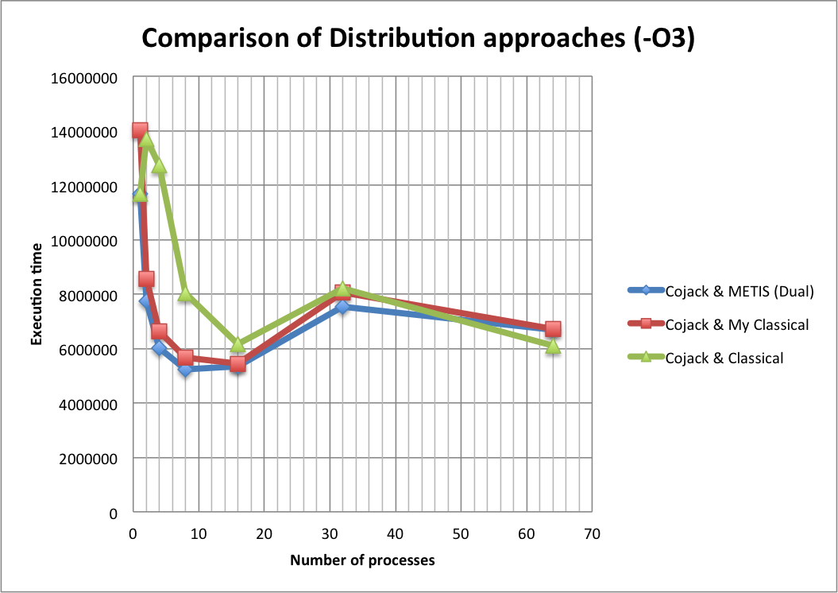
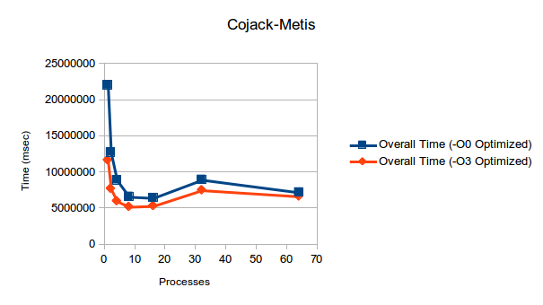
Results after tuning

Slide 15
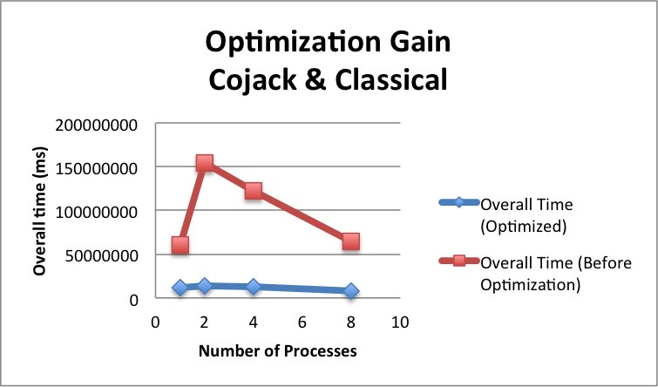
Results after tuning (Cont.)
# of Processes | Cojack-Metis | Pent-Metis
2 | 7.8% | 6.97%
4 | 17.87% | 16.25%
8 | 28.86% | 14.18%

Slide 16
Conclusion
From First Assignment
Binary I/O instead of ASCII
-O3
Mixture of flop counter and timers are not possible
From Second Assignment
To reduce the metis overhead involved in the data distribution part → ParMETIS can be considered.
To reduce the overall time further → MPI I/O can be implemented in the finalization part.

Slide 17
Thanks for your attention
Questions?

